Slide 1
react optimizations introduction
Using react and Redux, may 2022

Slide 2
agenda
Reconciliation
Anonymous functions inside jsx
use memo, use callback
shouldComponentUpdate
React.memo
React.lazy
Context optimisation

Slide 3
reconciliation
React reconciliation is a “diffing” algorithm
https://reactjs.org/docs/reconciliation.html
Elements of different types
This heuristic algorithm is based on following:
1. Two elements of different types will produce different trees.
2. The developer can hint at which child elements may be stable across different renders with a key prop.

Slide 4
reconciliation
Elements of the same type
When comparing two React DOM elements of the same type, React looks at the attributes of both, keeps the same underlying DOM node, and only updates the changed attributes.
Render method
When a component updates, the instance stays the same, so that state is maintained across renders. React updates the props of the underlying component instance to match the new element.
Next, the render() method is called and the diff algorithm recurses on the previous result and the new result.

Slide 5
agenda
Reconciliation
Anonymous functions inside jsx
use memo, use callback
shouldComponentUpdate
React.memo
React.lazy
Context optimisation

Slide 6
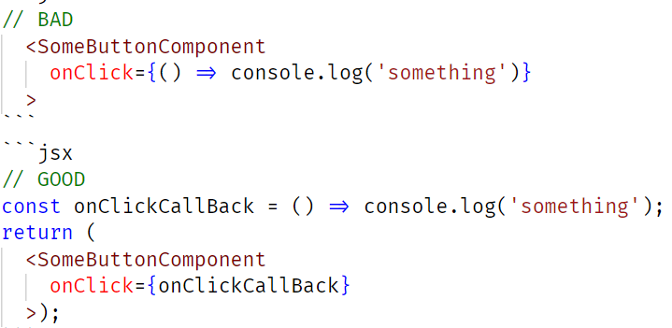
Anonymous functions inside jsx
problem
This creates a performance problem for React reconciliation because anonymous function is recreated on every render pass and will thus always trigger a real DOM re-render

Slide 7
Anonymous functions inside jsx
research
https://www.matthewgerstman.com/tech/performance-testing-anonymous-functions/
Conclusion:
I am very comfortable with the statement that inline anonymous functions have a negligible impact on application performance.

Slide 8
agenda
Reconciliation
Anonymous functions inside jsx
use memo, use callback
shouldComponentUpdate
React.memo
React.lazy
Context optimisation

Slide 9
use memo, use callback
description
useCallback gives you referential equality between renders for functions. useMemo gives you referential equality between renders for values.
useCallback and useMemo both expect a function and an array of dependencies. The difference is that useCallback returns its function when the dependencies change while useMemo calls its function and returns the result.

Slide 10
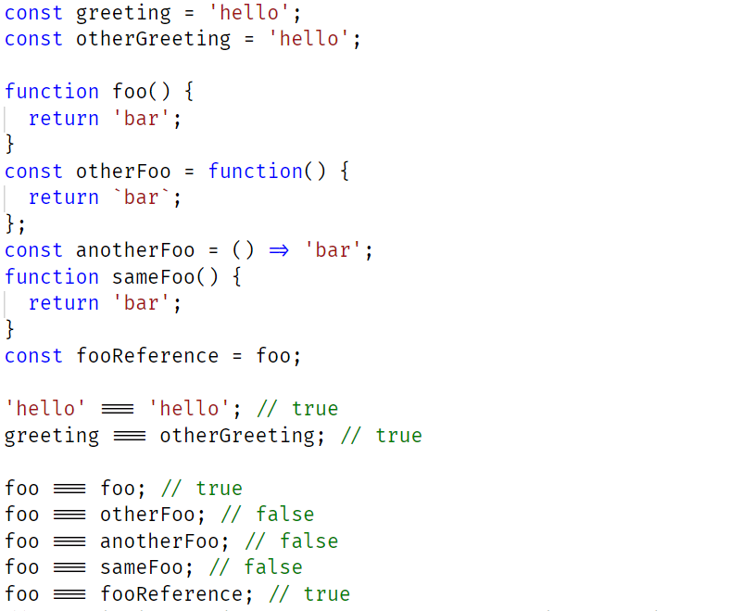
use memo, use callback

Slide 11
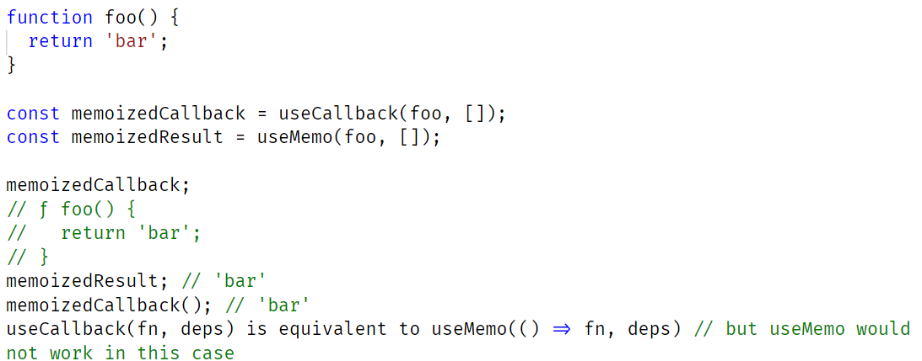
use memo, use callback

Slide 12
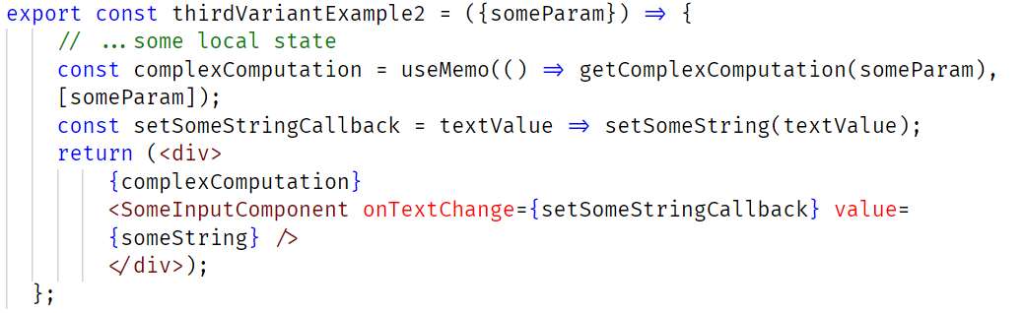
use memo, use callback

Slide 13
use memo, use callback
MemoExample
CallbackExample
Enjoy ☺

Slide 14
agenda
Reconciliation
Anonymous functions inside jsx
use memo, use callback
shouldComponentUpdate
React.memo
React.lazy
Context optimisation

Slide 15
shouldcomponentupdate
To our advantage
If you are certain that rerendering process should not occur even if props are changed, you can override shouldComponentUpdate function and prevent rerendering is specific cases, this method returns true by default, we just return false in certain cases
Pure components
Pure component similar to shouldComponentUpdate, (if props or state changes but the values compared are the same, no need to rerender component, we could implement this using shouldComponentUpdate, however if we use React.PureComponent, this component has this implemented by default. It only does shallow comparison, but does it check objects and arrays (could be an issue with refs)), pure components only work with class components
However, we can create memoized functional components

Slide 16
agenda
Reconciliation
Anonymous functions inside jsx
use memo, use callback
shouldComponentUpdate
React.memo
React.lazy
Context optimisation

Slide 17
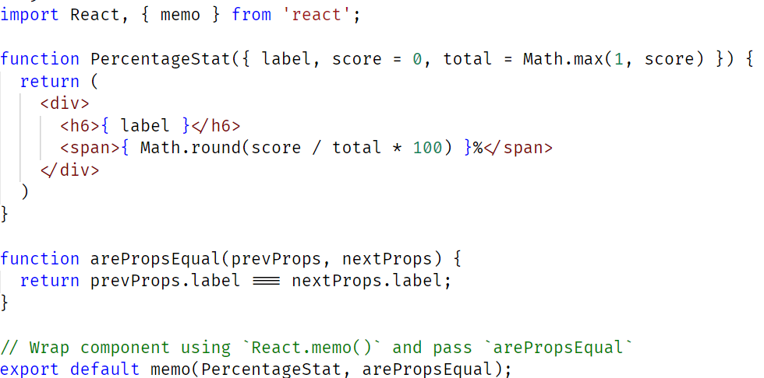
memo

Slide 18
agenda
Reconciliation
Anonymous functions inside jsx
use memo, use callback
shouldComponentUpdate
React.memo
React.lazy
Context optimisation

Slide 19
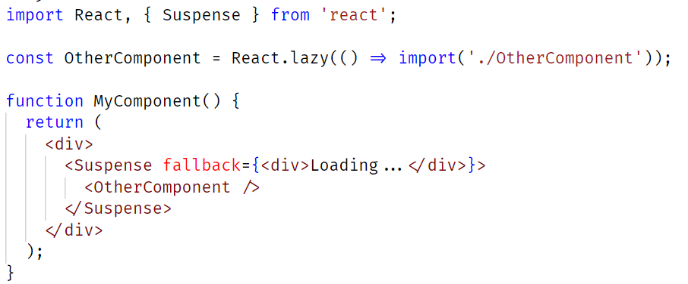
Lazy

Slide 20
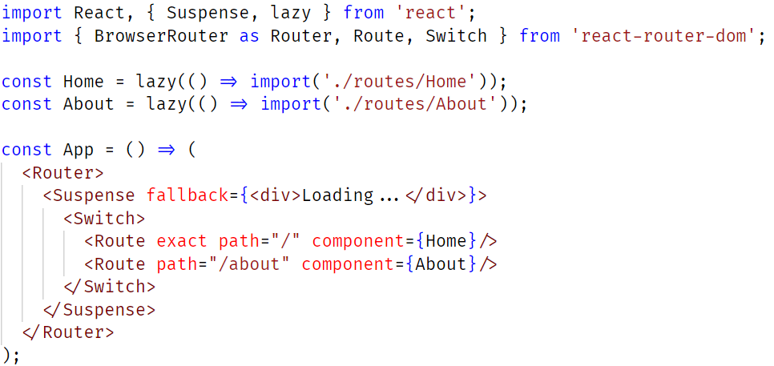
Lazy

Slide 21
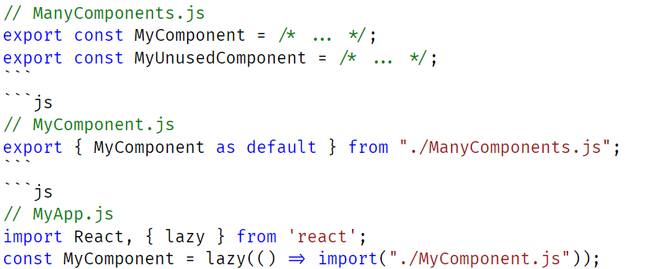
Lazy
React.lazy currently only supports default exports. If the module you want to import uses named exports, you can create an intermediate module that reexports it as the default.

Slide 22
agenda
Reconciliation
Anonymous functions inside jsx
use memo, use callback
shouldComponentUpdate
React.memo
React.lazy
Context optimisation

Slide 23
Context optimization
When the parent of ContextProvider re-renders, ContextProvider will re-render too, which will recreate the value, thus changing its reference.
Then, React will detect a context value change, and every component consuming our Context will update ! One of solutions is to wrap value of provider with useMemo
Use separate contexts to avoid the case in which change of one part of the value of context is forcing rerendering of all consumer components. Some components might not use other part of the context value and not need to be rerendered.

Slide 24
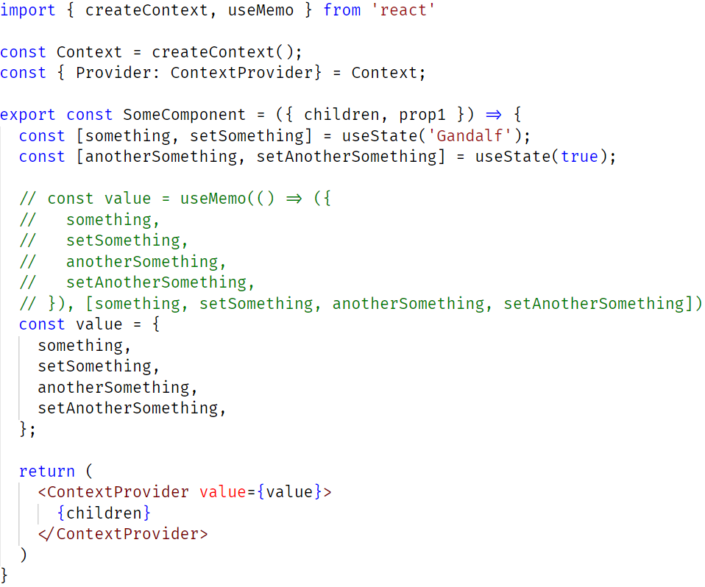
Context optimization

Slide 25
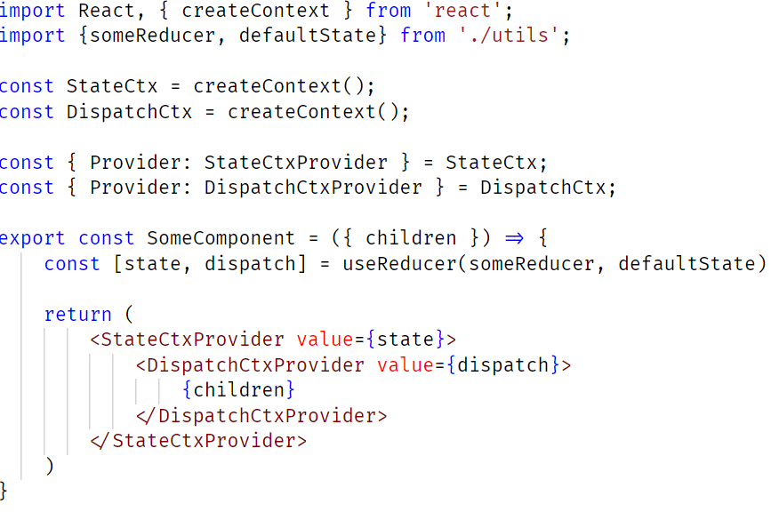
Context optimization

Slide 26
Context optimization
Separate contexts example
Enjoy ☺

Slide 27
Thoughts after investigation
React is really fast and adding complexity in the name of performance when performance is good enough is just wasteful of your "complexity budget"
- Kent C. Dodds

Slide 28
THANK YOU
Dejan JOksimovic
Frontend developer
dejan.joksimovic@endava.com

